Slide 1








AI Agents
Presented by: Sourour Hammoud
September 6,2025

Slide 2

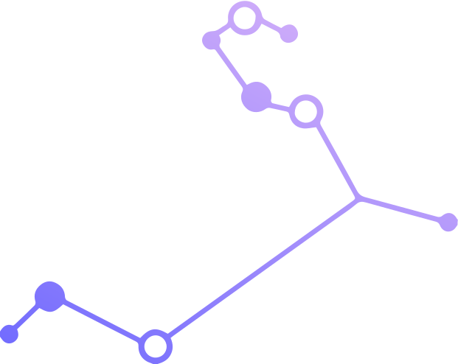



What is AI Agents

Slide 3





Tools
Memory
LLM
AI Agent

Slide 4




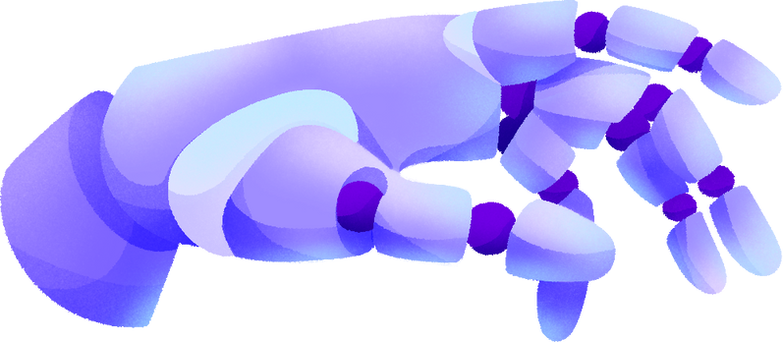
Components of AI Agent
1
2
3
Environment
Sensor
Actuators

Slide 5
Design Pattern

Slide 6
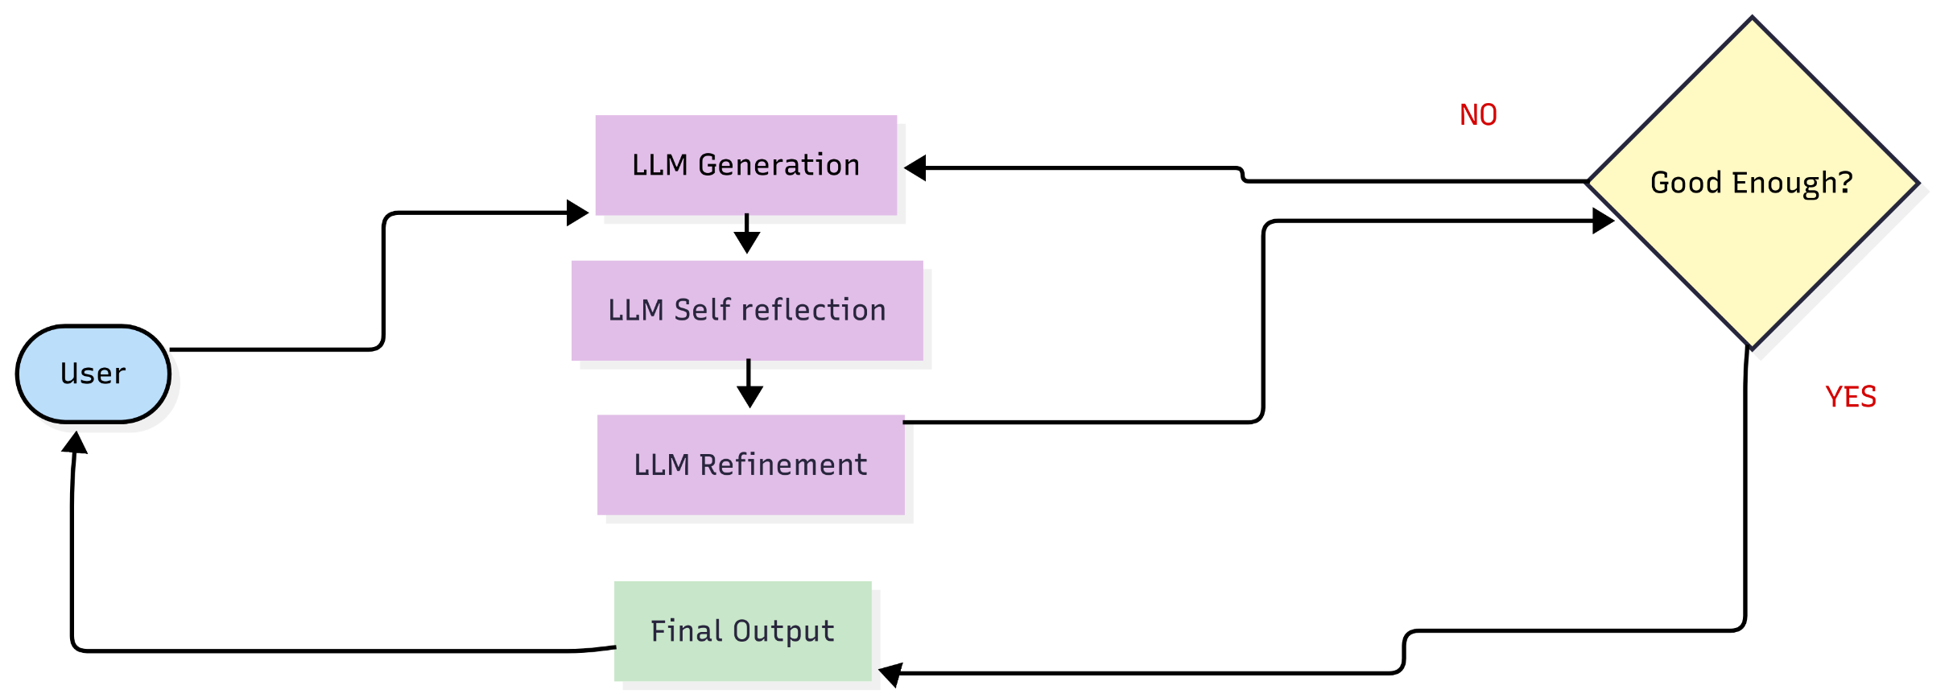
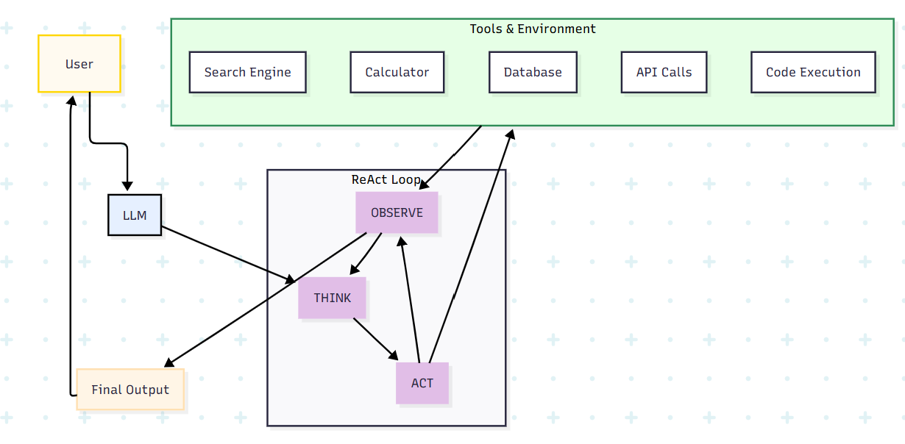
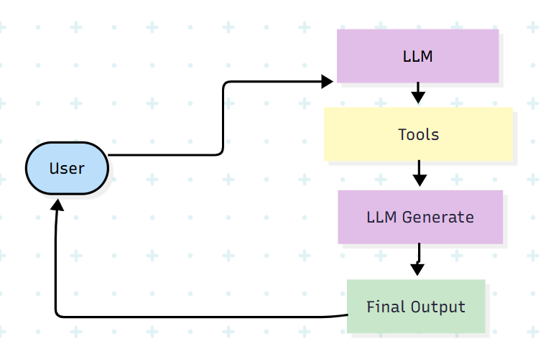
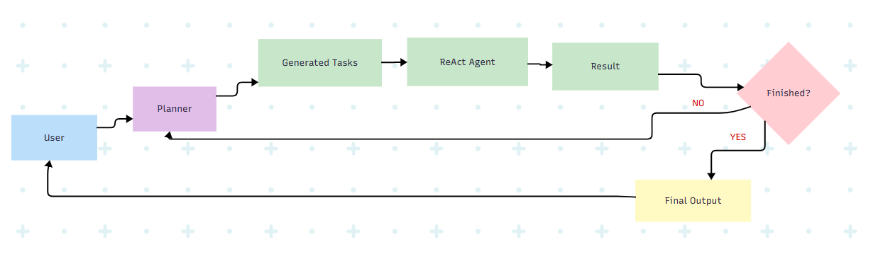
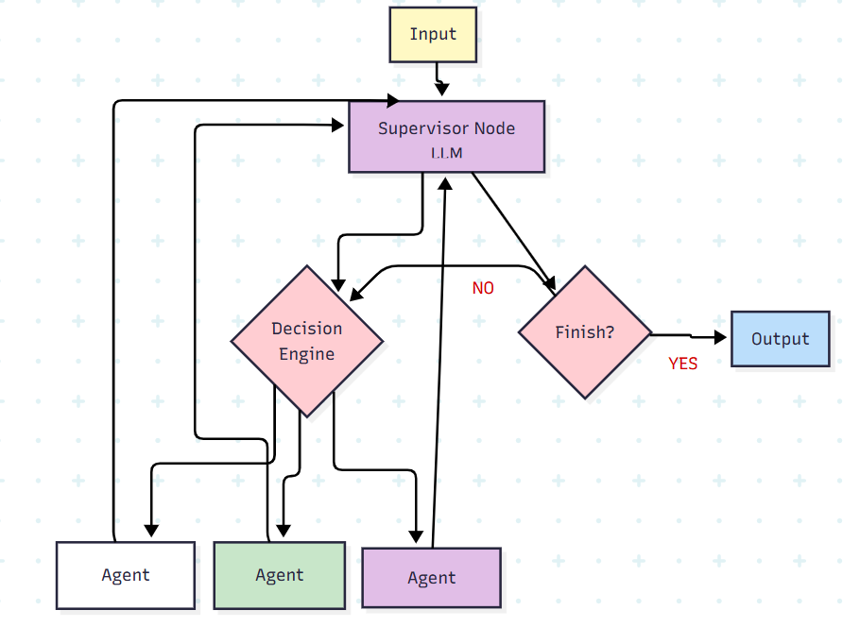
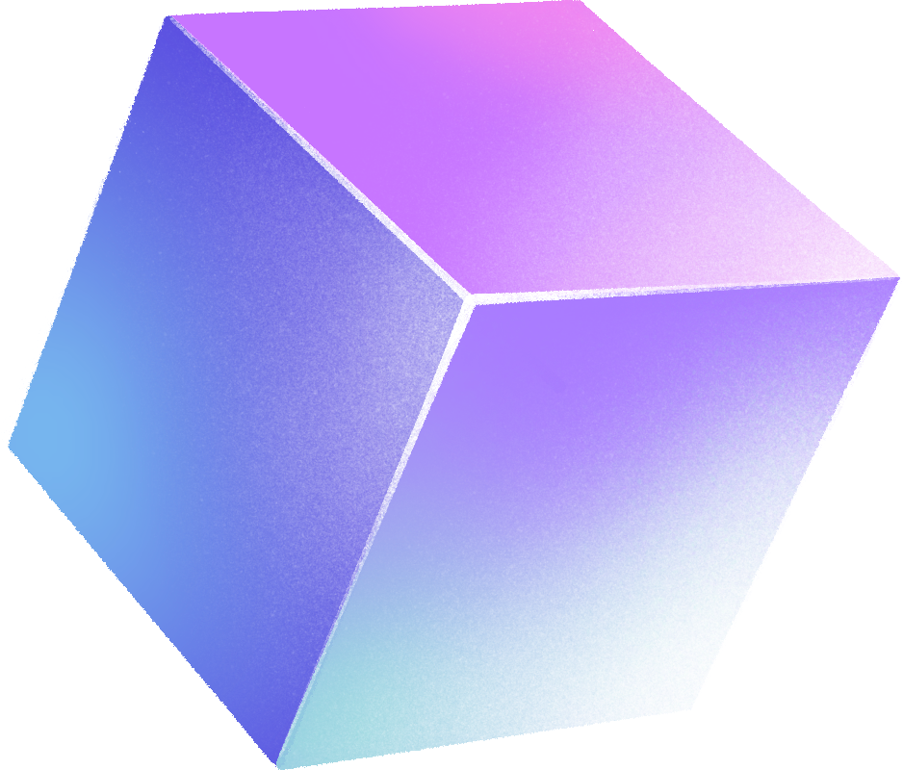
1
Reflection Agent
2
ReAct Agent
3
Tool use Agent
4
Planner Agent
5
Multi Agent

Slide 7



Examples of AI Agent
Self Driving Car
SIRI

Slide 8
Frameworks

Slide 9
Frameworks
Smolagents is a lightweight framework developed by Hugging Face that makes it easier to build, run, and combine AI agents. It provides tools to connect models, manage reasoning steps, and interact with external tools or APIs in a simple and efficient way.
1
Smolagents
Default Toolbox
UserInputTool
DuckDuckGoSearchTool
PythonInterpreterTool
finalAnswerTool
GoogleSearchTool
VisitWebpageTool
Code Agent
Tool Calling Agent

Slide 10
Frameworks
LangChain is an open-source framework that helps developers build applications powered by large language models (LLMs). It makes it easier to connect LLMs with data sources, memory, tools, and workflows to create chatbots, agents, and other AI applications.
2
LangChain
LangChain
Tools
Agents
LLMs
Zep
Memory
AIPulgin
Tool
DuckDuck
GoSearchRun
Memory
Vector
Store
Retrieve
Memory
Conservation
Buffer
memory
Conservation
Summery
Memory
Conservation
Buffer
Window
Memory
Load
tools
Initialize
Agent
Prompt
Open
AI
Core
Message
Runnable
GPT4All
Llama
cpp
Agent
Type
GoogleSearchRun

Slide 11
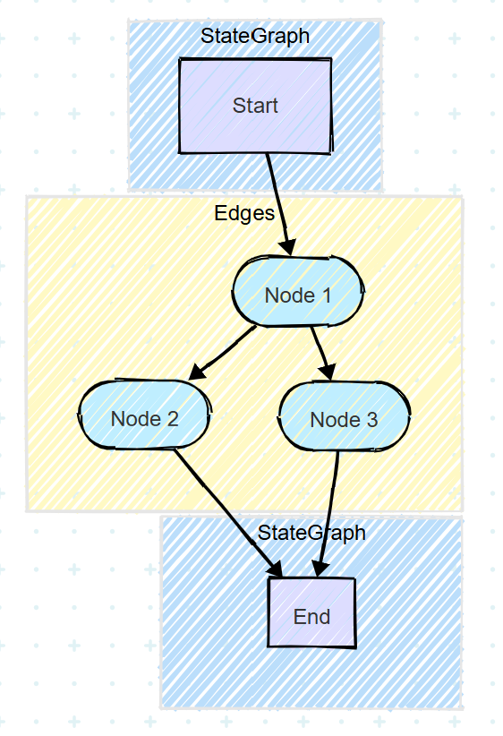
Frameworks
LangGraph is a framework built on top of LangChain that lets you design AI applications as graphs of nodes (where each node is a step like reasoning, tool use, or memory). It is especially useful for building multi-agent systems and complex workflows, giving you more control and reliability compared to a simple chain.
3
LangGraph

Slide 12
Frameworks
LlamaIndex is a framework that helps connect large language models (LLMs) with your own data. It organizes data into indexes and provides ways for LLMs to retrieve and use the right information when answering questions or performing tasks.
4
LlamaIndex
LlamaIndex
Core
Tools
LLMs
Vector
Store
Index
Service
Context
Simple
Directory
Reader
OpenAI
Query
Engine
Tool
Anthropic
Function
Tool
Agent
ReAct
Agent

Slide 13
Frameworks
5
AutoGen is a framework from Microsoft for building applications with multiple AI agents that can talk to each other and collaborate with humans to solve complex tasks.
AutoGen
AutoGen
Assistant
Agent
User
Proxy
Agent
GroupChat
GroupChat
Manager

Slide 14
Guardrails

Slide 15
Guardrails
Tool Guardrails
Input Guardrails
Tools
External World
User
Prompt
Model
Output Guardrails
Response

Slide 16
Anomaly Detection

Slide 17






Anomaly Detection
Outliers
Detection
Novelty
Detection

Slide 18
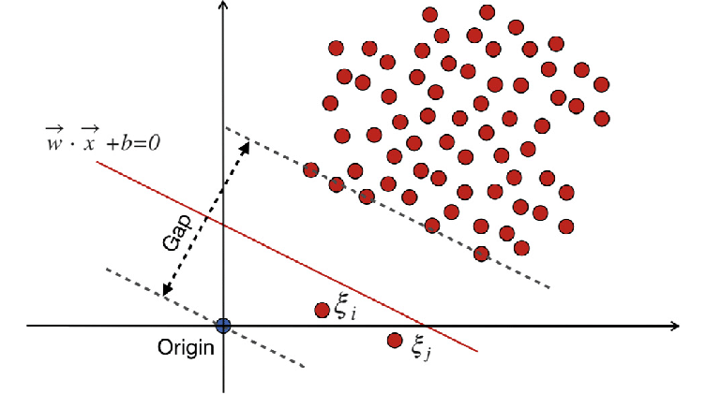
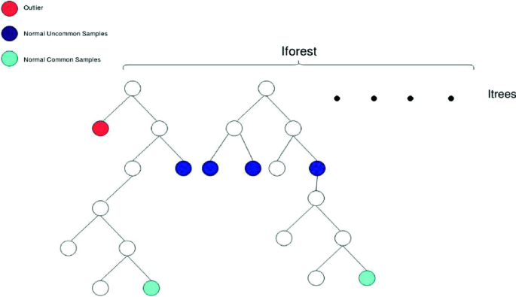
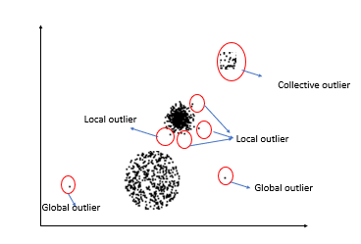
Algorithm of Anomaly Detection
1
Isolation Forest is an algorithm for anomaly detection that works by randomly splitting data to isolate points; anomalies are easier to isolate than normal points.
Isolation Forest
Local Outlier Factor (LOF) is an anomaly detection algorithm that measures how isolated a point is compared to its neighbors; points with much lower density than their neighbors are considered outliers.
2
Local Outlier Factor
3
One-Class SVM is a type of Support Vector Machine used for anomaly detection or novelty detection. It learns a decision boundary around normal data and identifies whether new data points belong to the same distribution (normal) or are outliers (anomalies).
One Class SVM

Slide 19

Any Questions?

